Slide 1
Exceptions (http://docs.oracle.com/javase/tutorial/essential/exceptions/index.html)
Notes:
A software is usually organized as a folder. A folder containing java classes is call as a package but this folder must be created by the Java complier.
We all experience about unpleasant feeling when facing errors or exceptions caused by a software. Now you are programmers, you surely do not want your programs existing errors implicitly.

Slide 2
Objectives
Exception Handling
try block
catch block
finally block
custom exception class

Slide 3
Exceptions
Exception: Error beyond the control of a program. When an exception occurs, the program will terminate abruptly.
When a program is executing something occurs that is not quite normal from the point of view of the goal at hand.
For example:
a user might type an invalid filename;
An accessed file does not exist of might contain corrupted data;
a network link could fail;
…
Circumstances of this type are called exception conditions in Java and are represented using objects (All exceptions descend from the java.lang.Throwable).

Slide 4
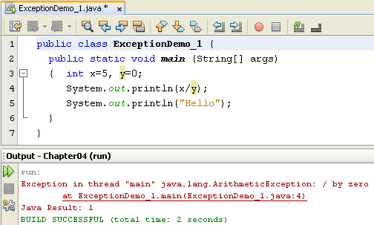
Exceptions
The following program causes an exception.
Exceptions are pre-defined data (Exception classes) thrown by JVM and they can be caught by code in the program

Slide 5
Catching exceptions: try catch finally
try block
try {
< statements may cause exceptions >
}
e?
false
true
catch ( ExceptionType1 e1 ) {
< statements handle the situation 1>
}
catch block
catch ( ExceptionType2 e2) {
< statements handle the situation 2>
}
finally block
finally {
< statements are always executed >
}
If no exception is thrown
in the try block, all catch blocks are bypassed
If an exception arises, the first matching catch block, if any, is executed, and the others are skipped

Slide 6
The finally block (1)
A try block may optionally have a finally block associated with it.
The code within a finally block is guaranteed to execute no matter what happens in the try/catch code that precedes it.
The try block executes to completion without throwing any exceptions whatsoever.
The try block throws an exception that is handled by one of the catch blocks.
The try block throws an exception that is not handled by any of the catch blocks

Slide 7
Two Kinds of Exception
Checked exception
Must be handled by either the try-catch mechanism or the throws-declaration mechanism.
Runtime exception
The right time to deal with runtime exceptions is when you’re designing, developing, and debugging your code. Since runtime exceptions should never be thrown in finished code.

Slide 8

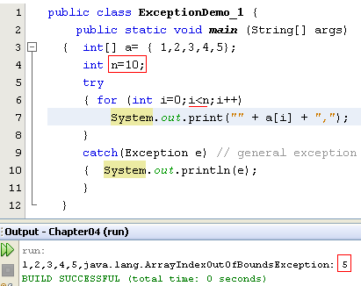
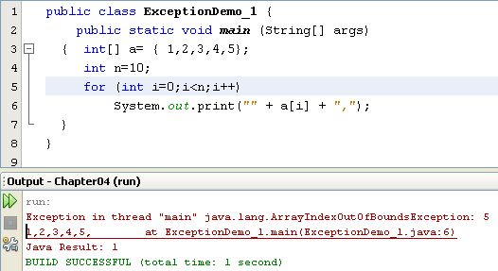
Kinds of Exceptions
Checked Exceptions
(We must use the try catch blocks or throw)
Unchecked- Exceptions
Program Bugs
(We may not use the try catch blocks)
Refer to the Java.lang documentation for more information.
Notes:
-Checked exceptions are checked at compile-time. It means if a method is throwing a checked exception then it should handle the exception using try-catch block or it should declare the exception using throws keyword, otherwise the program will give a compilation error. It is named as checked exception because these exceptions are checked at Compile time.
- What are Unchecked exceptions?
Unchecked exceptions are not checked at compile time. It means if your program is throwing an unchecked exception and even if you didn’t handle/declare that exception, the program won’t give a compilation error. Most of the times these exception occurs due to the bad data provided by user during the user-program interaction. It is up to the programmer to judge the conditions in advance, that can cause such exceptions and handle them appropriately. All Unchecked exceptions are direct sub classes of RuntimeException class.

Slide 9
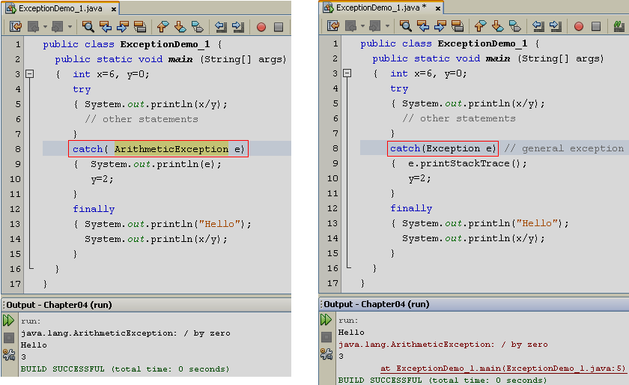
Catching specific/general-level exception

Slide 10
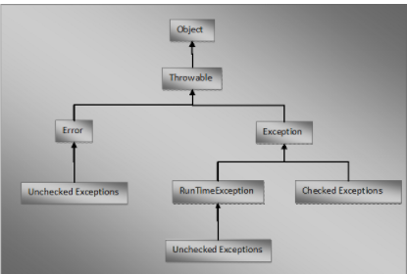

Slide 11
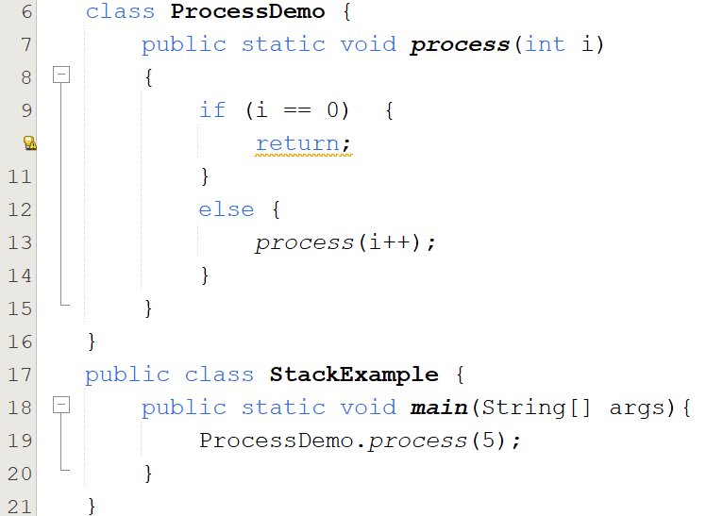
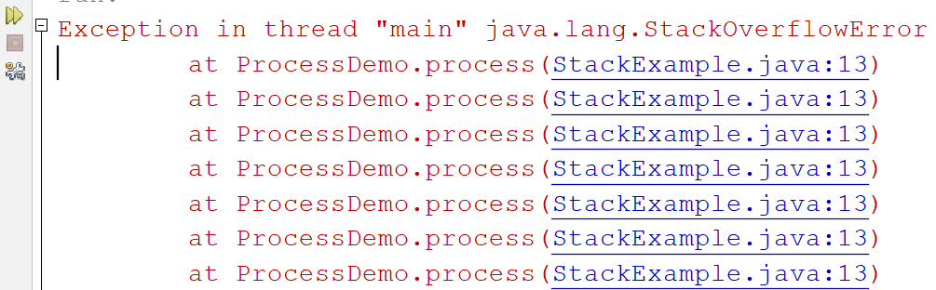
Error Class

Slide 12
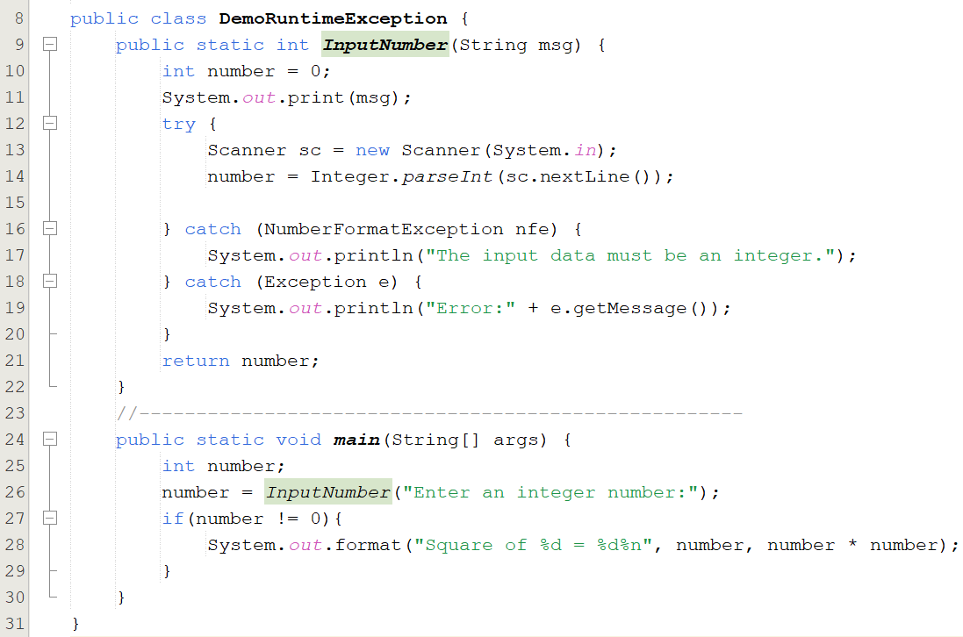


Demo Runtime Exception

Slide 13
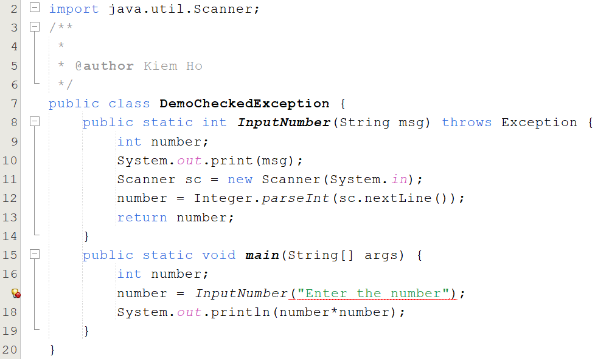

Demo Checked Exception

Slide 14
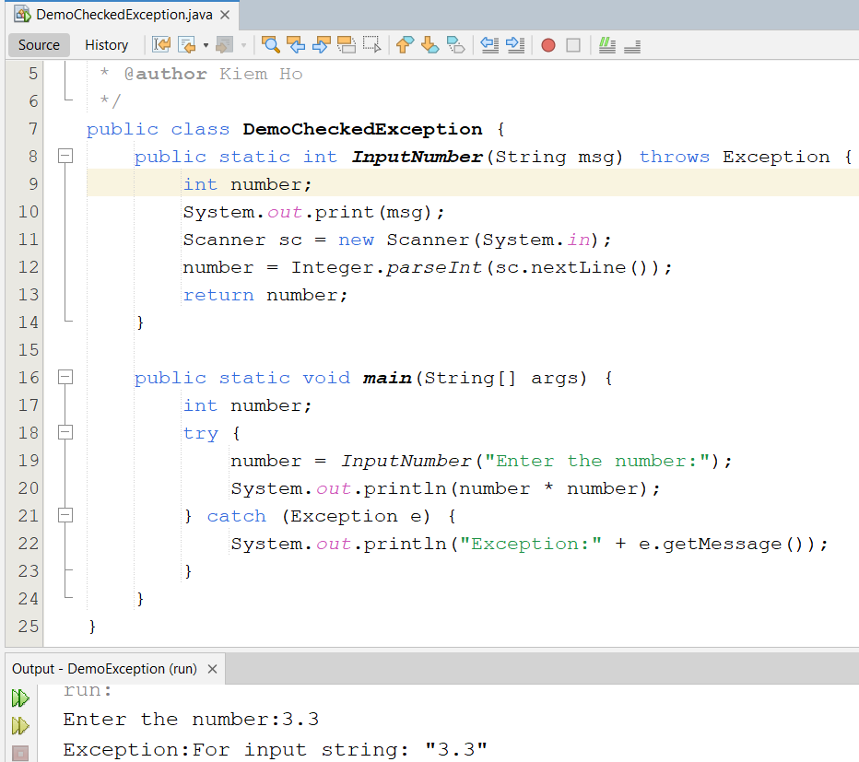
Demo Checked Exception

Slide 15
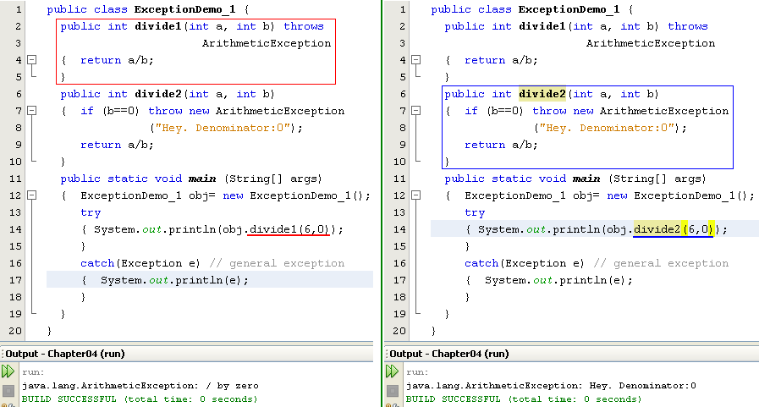
Throwing exceptions in methods
May we intentionally throw an exception? → YES

Slide 16

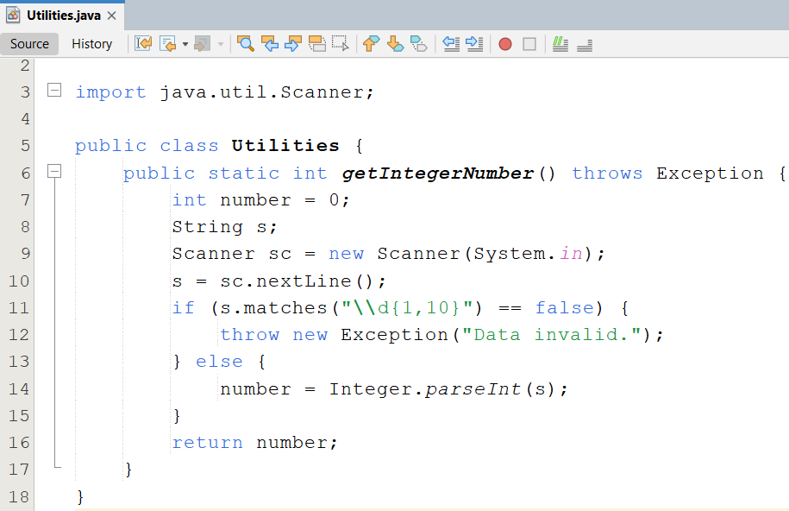
Throwing exceptions in methods-1

Slide 17
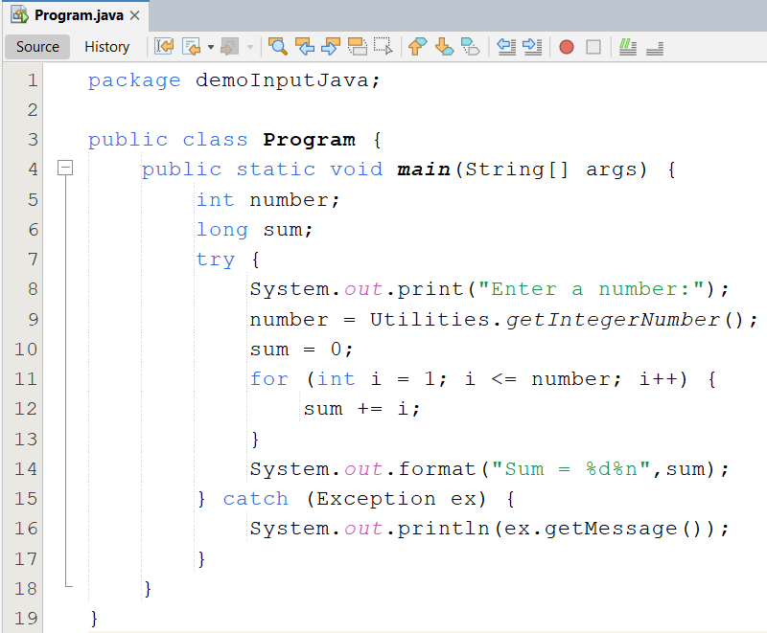
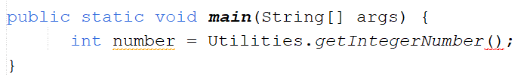
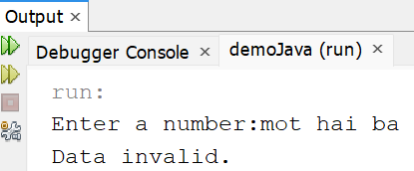
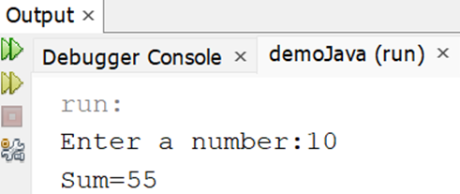
Throwing exceptions in methods-2

Slide 18
Exception Propagations
catch(...)
A()
B()
Stack for A()
Stack for B()
C()
Stack for C()
D()
Exception
Stack for D()
Stack trace
When an exception occurs at a method, program stack is containing running methods ( method A calls method B,….). So, we can trace statements related to this exception.

Slide 19
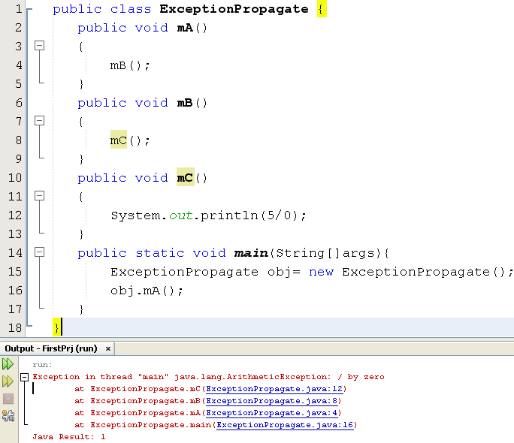
Exception Propagations

Slide 20
Nesting of try/catch Blocks
A try statement may be nested inside either the try or catch block of another try statement.
try { // Pseudo code. open a user-specified file } catch (FileNotFoundException e) { try { // Pseudo code. open a DEFAULT file instead ... } catch (FileNotFoundException e2) { // Pseudo code. attempt to recover ... }
}

Slide 21
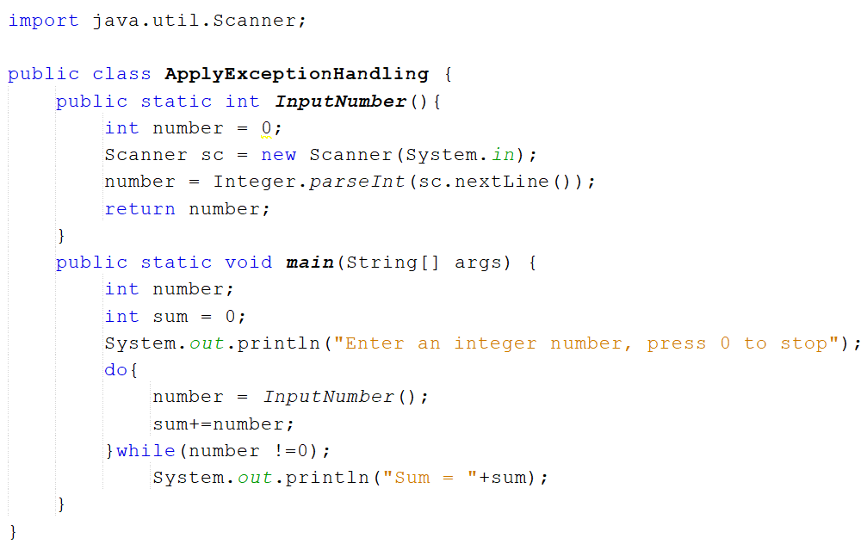
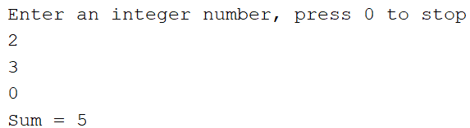
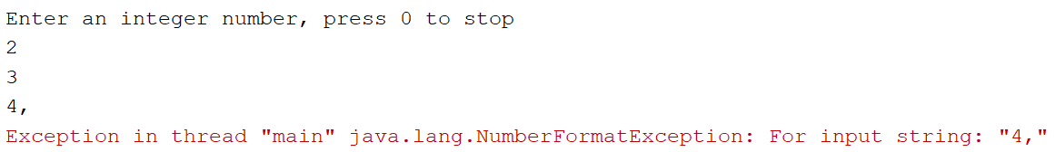
Apply Exception Handling 01

Slide 22
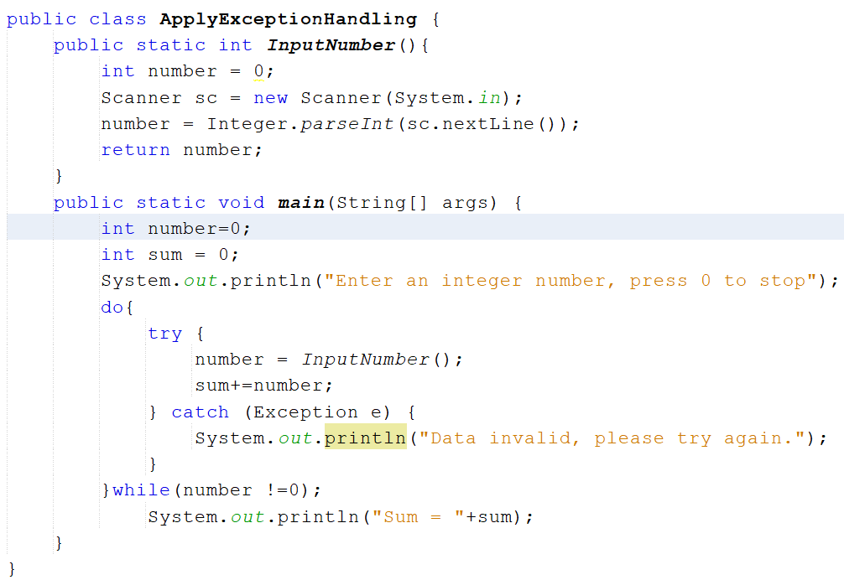
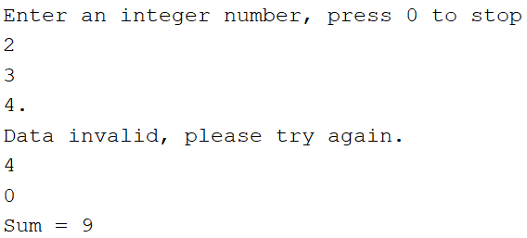
Apply Exception Handling 01

Slide 23
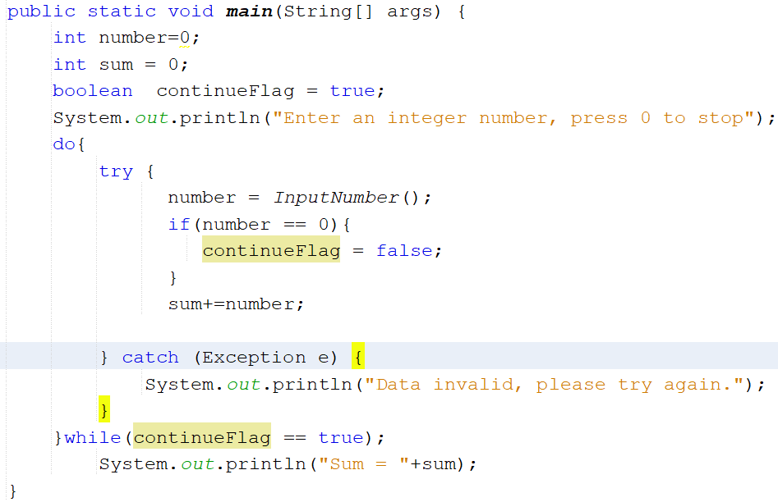
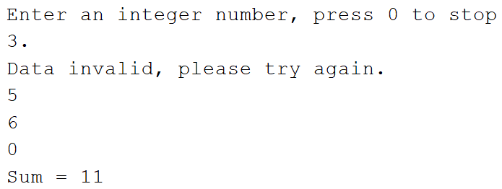
Apply Exception Handling 01

Slide 24
Creating Your Own Exception Classes (1)
Decide whether you want a checked or a runtime exception.
Checked exceptions should extend java.lang.Exception or one of its subclasses.
Runtime exceptions should extend java.lang.RuntimeException or one of its subclasses

Slide 25
Creating Your Own Exception Classes (2)
Create your own exception class with it’s constructor
class InvalidAge extends Exception{
public InvalidAge(String mes) {
super(mes);
}
}

Slide 26
Creating Your Own Exception Classes (3)
//Use it in some method
class MyClass{
public void MyMethod(int a) throws InvalidAge{
if(a<0)
throw new InvalidAge("Age invalid!");
}
}

Slide 27
Creating Your Own Exception Classes (4)
//Using try-catch when this method is called
try {
MyClass class1 = new MyClass();
class1.MyMethod(-5);
} catch (InvalidAge ex) {
System.out.println(ex.getMessage());
}

Slide 28
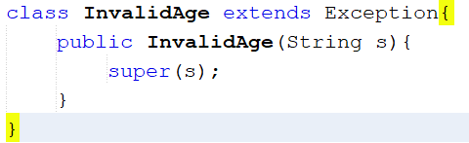
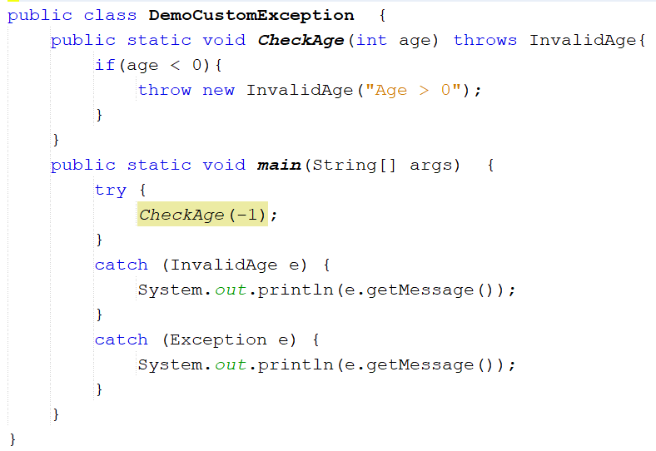
Creating Your Own Exception Classes (5)

Slide 29
Exceptions and Overriding
When you extend a class and override a method, the Java compiler insists (đòi hỏi) that all exception classes thrown by the new method must be the same as, or subclasses of, the exception classes thrown by the original method.

Slide 30
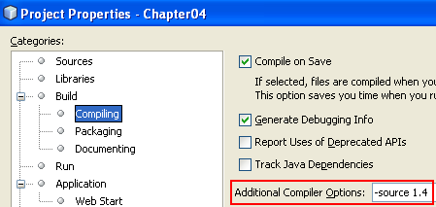
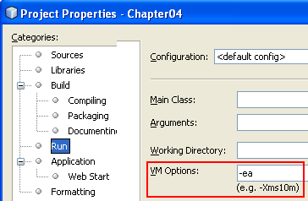
Assertions
Assertions are introduced in Java 1.4
2 Ways of writing assertion statements:
assert expression; // true-false condition
assert expression1:expression2; //
condiontion:ExceptionMessage
You must specify options when the program is compiled and run.
We can replace an assertion with an if statement.
In Java from 1.5, the keyword assert is removed.

Slide 31
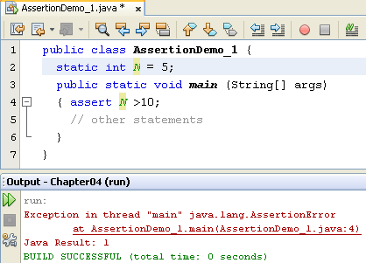
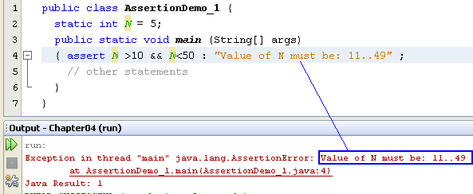
Assertions…

Slide 32
Summary
Exception Handling
Multiple Handlers
Code Finalization and Cleaning Up (finally block)
Custom Exception Classes
Assertions

